Slide 1
LARGE DISPLAYS
Channel Overview

Slide 2
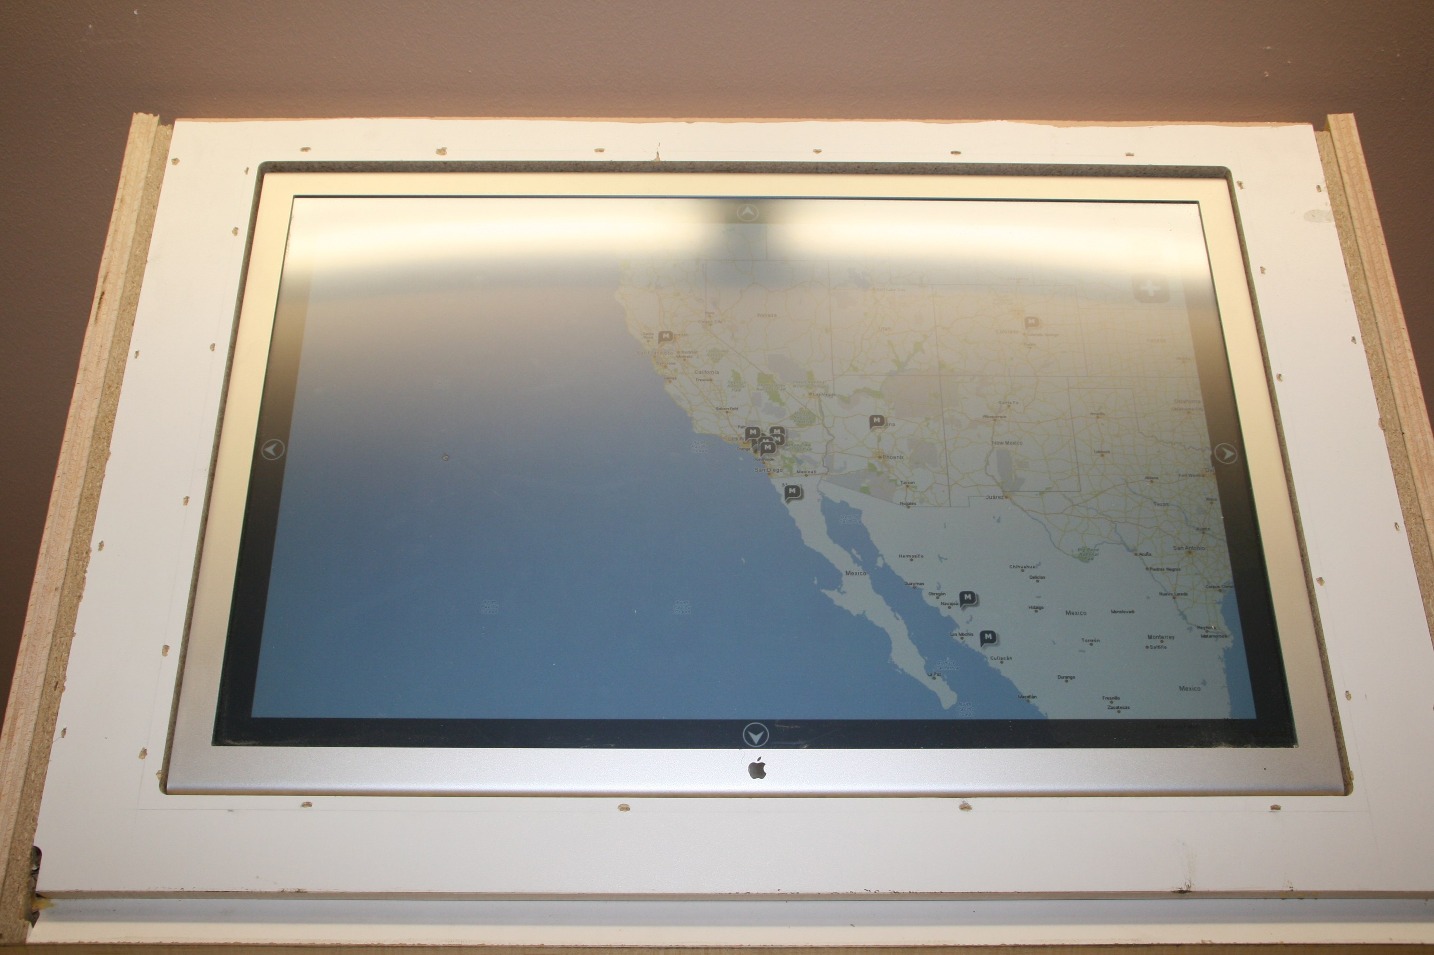
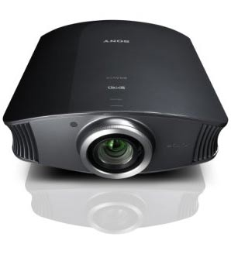
Overview
Because we are interactive, focusing on items with inputs
Touch Screens
Projectors

Slide 3
Touch Screens
Stuff We Do Well
Can build software with our current skillset
Flash/Air
Silverlight
Design isn’t too far off from how we do things for the web
Things To Keep In Mind
There are significant UX changes to touch screens
Can be a much more rich experience because we don’t have load times (if local)

Slide 4
Touch Screens
Pricing
Not too pricy
Found a few at 5500 for a 40 inch
Can also modify regular displays or large monitors with overlays that respond to touch
Example of modified 30 inch apple →
Example:

Slide 5
Touch Screen Reminders
Be careful of how you develop drag and drop items
Depending on hardware your finger can bounce as you drag
Glass surfaces have a tendency to be much smoother than a plastic coating
Placement of items
You don’t want navigation on the bottom due to covering it as you click on other items
No over states

Slide 6
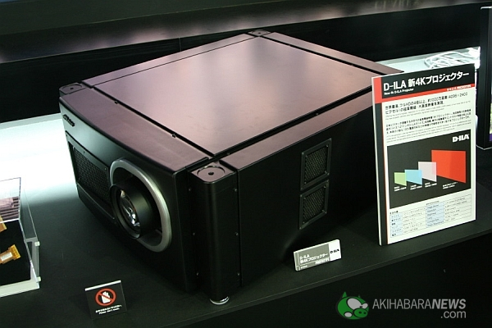
Projectors
Hardware:
Lots of different projectors at any price range
Range from a few hundred to a few hundred thousand →
(4096×2400 pixels where a 30 inch monitor is 2560x1600)
Special options include:
802.11 N
HD
3D

Slide 7
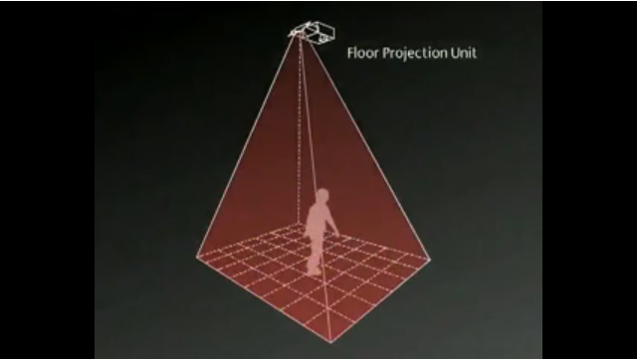
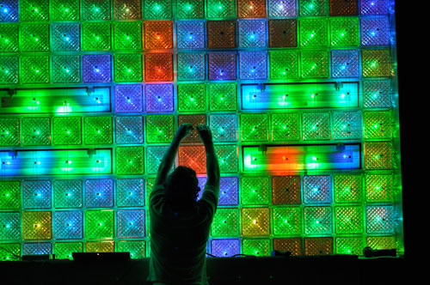
Projectors
What have others done?
Building Projections
Floor Projected games
Alternative surfaces
Using blocks at lights →

Slide 8
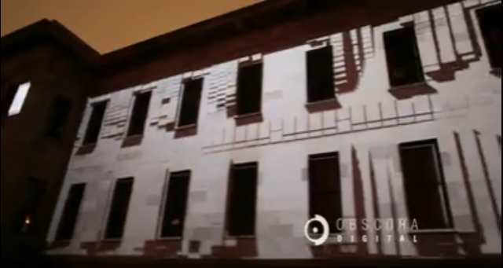
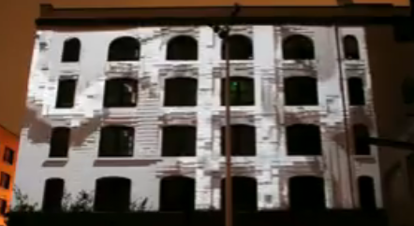
Building Projector Example
Project a simulated texture on a building via projector
Link
In this example they have 7 HD projectors placed over a 6000 pixel plate.
Used a mixture of 3D Studio Max, and FireFrame for syncing the projectors

Slide 9
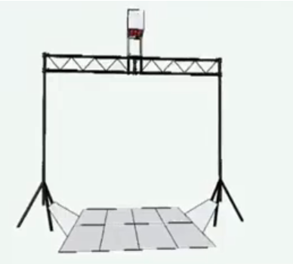
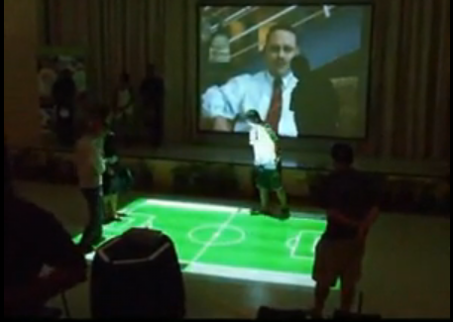
Floor Projector Example
Vertically mounted projector uses floor as surface
Link
Sensors then detect where you’re standing and allow you to interact with the projected content
Useful for games, interactive advertisements or even giving directions

Slide 10

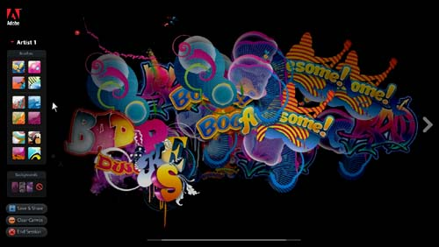
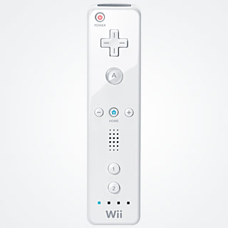
Projector Inputs
Facial Recognition
Ex. Can move the perspective on the screen based on location of your face
Wii Motes
Ex. Canvas project for Adobe Max
Motion Detection
Ex. Based on movement you can move items
Sapient example

Slide 11
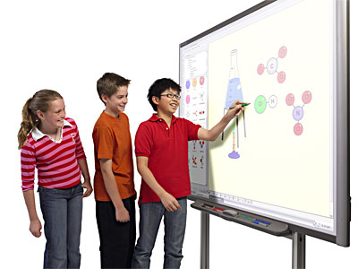
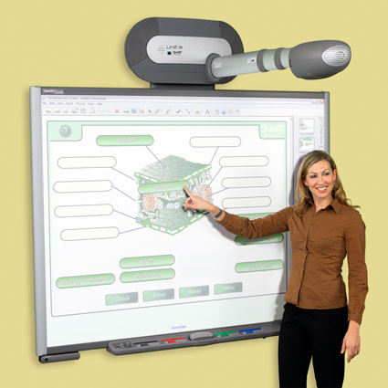
Projector Inputs
Laser Pointers
Work the same as a mouse
Touch Screen Whiteboards
Can be built for cheep with Wii mote
Have more expensive pre built ones

Slide 12
Thoughts?
What Industries / Clients does the work for?
Almost Any
Any Ideas?
Mall touch screen games
Digital outfit based on location and height in a fitting room
Customize your car in a dealership using a touch screen

